Slide 1
Teacher
slides

Slide 2
Activity 1: Throw the ball
STEP 1
Everyone in the room forms a circle.
STEP 2
When you catch the ball, say your name out loud.
STEP 3
Throw the ball to another person who did not have the ball yet.

Slide 3
Activity 1: Where in the world?
You have two minutes to think of three clues that describe, but do not give away, either the country you are from (OR) your favourite foreign place you have visited or dream of visiting.

Slide 4
Activity 1: Where in the world?
You have two minutes to think of three clues that describe, but do not give away, either the country you are from (OR) your favourite foreign place you have visited or dream of visiting.

Slide 5
Activity 2: “Good” teamwork
In small groups, brainstorm, generate and capture your ideas on what are the principles of being a ‘good team member.’ When finished, each group will be asked to present their findings.

Slide 6
Activity 3: Team allocation and collaboration tools
Brainstorm: What online collaboration tools are you familiar with?

Slide 7
Activity 4: Personal values and strengths
There is a strong correlation between your personal values and strengths you bring into your team. In this activity you will
Reflect on your values
Reflect on your strengths as a team member
Start developing your team culture

Slide 8
Activity 5: Concept of “challenge”
Find synonyms
to “challenge”?
challenge

Slide 9
Activity 5: Concept of “challenge”
Think of challenges in different perspectives considering:
1. Time (daily/ weekly/ … )
2. Scale (individual/ family/ work/ communities/ world)
3. Life stages (toddler/ child/ young adult)

Slide 10
Activity 5: Concept of “challenge”
How do you define challenge? Can you give an example of a challenge you’ve overcome? How did you address it? How did it change you as an individual?

Slide 11
Activity 6: What challenge?
https://sdgs.un.org/goals

Slide 12
Activity 6: What challenge?
In your group, have a discussion on different goals (taken eg. from sustainable goals) and select the one closest to your major or your general interests. Be prepared to report on the decision process they used (brainstorming, shortlisting, convincing/arguing)

Slide 13
Activity 7: What challenge?
In your group, identify and choose one of the most relevant environmental / societal challenges and present your findings using a collaboration tool of your choice.

Slide 14
Activity 8: Defining users?
Once your target group has been defined, think about how you will access it (e.g. questionnaires, interviews, field observation, etc.), and how practical it will be if done online. You will share their thoughts and results with the class.

Slide 15
Activity 9: Interview questions
(depends on the option and highly customized)

Slide 16
Activity 10: Designing questions
In your team, design a set of questions relevant for your challenge and target group.

Slide 17
Ideate

Slide 18
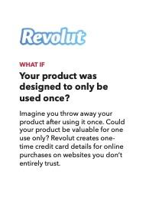
Activity 1: Warm up / creativity training
The warm up is a fun and creativity-boosting activity not requiring any preparation. The goal is to push the limits of students’ creativity so that they get ready for the upcoming tasks and get acquainted with their mock companies better. Two exemplary activities are suggested:
Option 1: The paperclip method, a brainstorming task for potential uses of a paperclip, that boosts creativity and also points out the benefits of teamwork.
Option 2: Brainstorm cards help to set students in a direction that is solution-oriented, optimistic and collaborative.
Paperclip method
Examples of Brainstorm cards

Slide 19
Activity 2: Teamwork through ideational techniques
This part revolves around (cultural) factors affecting the teamwork experience, and aims to help students in developing (self-)awareness of such factors and resulting behaviors, as well as approaches for creating good teamwork environments. Two exemplary activities are suggested:
Option 1: Case studies to illustrate and analyse teamwork situations at the workplace.
Option 2: Discussion of behavioral dimensions potentially affecting teamwork, including reflections of others’ and own behaviors, and approaches for creating positive teamwork environments.
An example of a case:
Behavioral dimensions according to Hofstede
Impact of Working Environment on Job Satisfaction

Slide 20
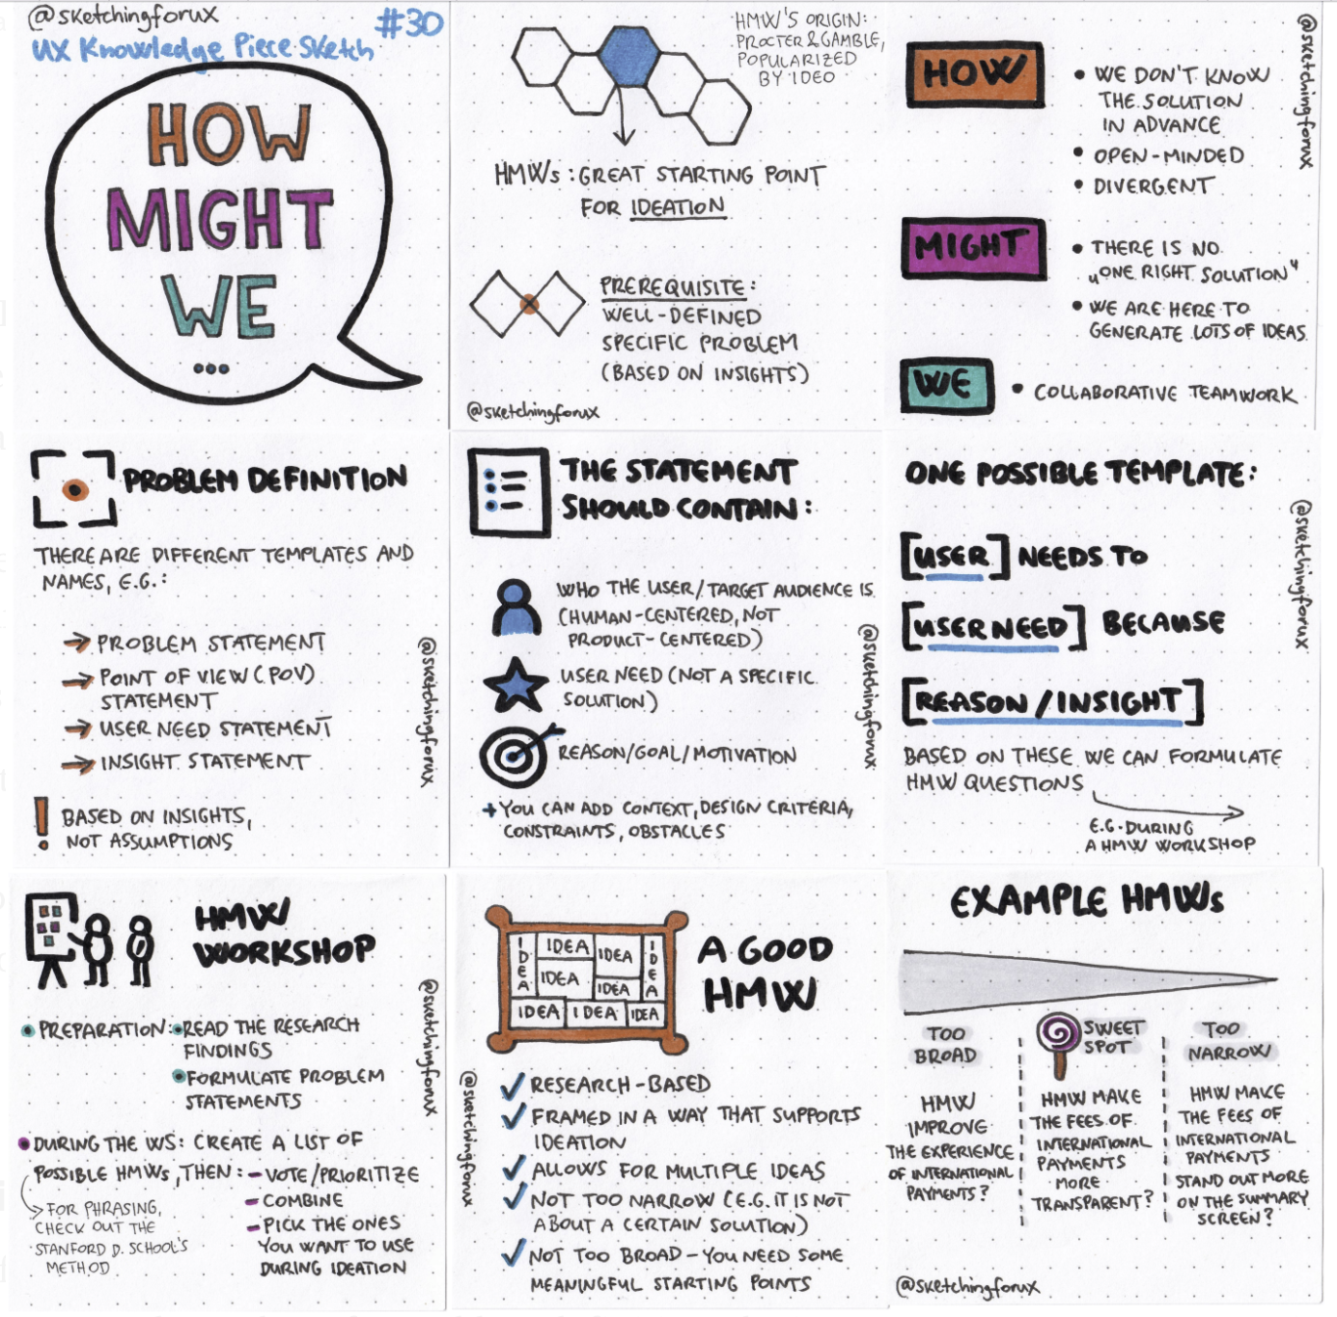
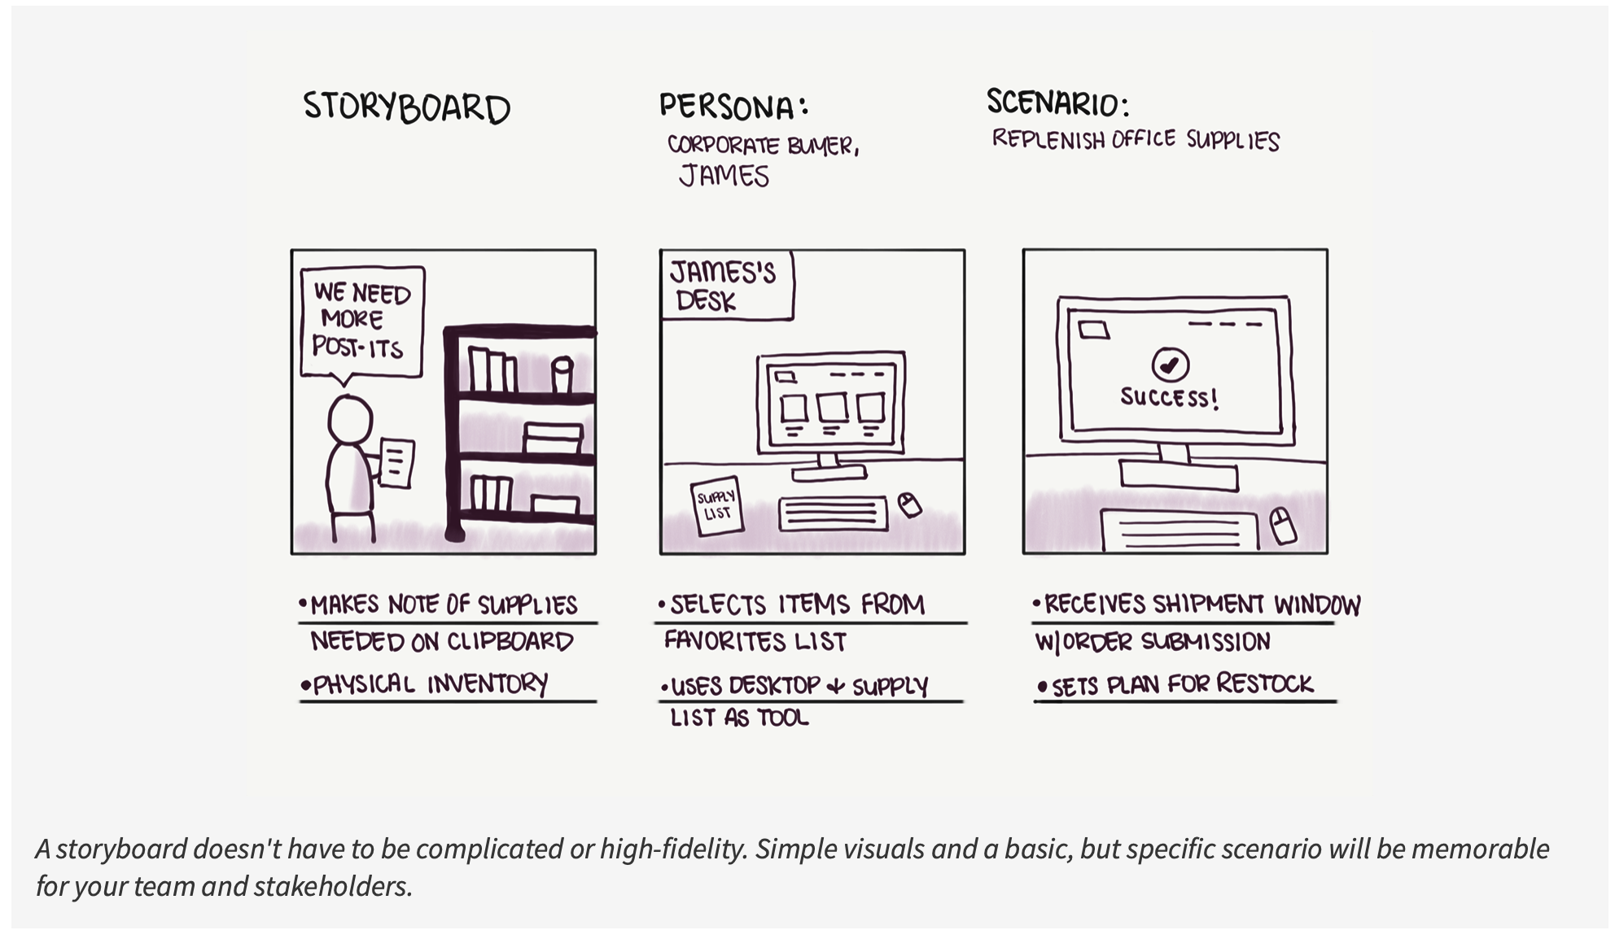
Activity 3: Brainstorming clients’ needs / identifying problems
Students should try to identify a mock client’s needs through brainstorming. This is a creative and concentrated process; students should be provided with an environment that facilitates free, open, and the non-judgemental sharing of ideas. The activity consists of two parts, which can be merged into one.
Part 1. How might we?
Part 2. Storyboarding
Storyboarding
How might we?

Slide 21
Activity 4: Collecting and refining ideas
This activity begins after the students generate and structure their ideas, it is time for collecting and refining the most suitable ones. The activity helps to make connections between ideas that will help students uncover patterns or themes.
Structuring can be done through an Affinity diagram, a great tool that gathers large amounts of data (ideas, opinions and issues) and organizes them into groupings based on their natural relationships.
Affinity diagram

Slide 22
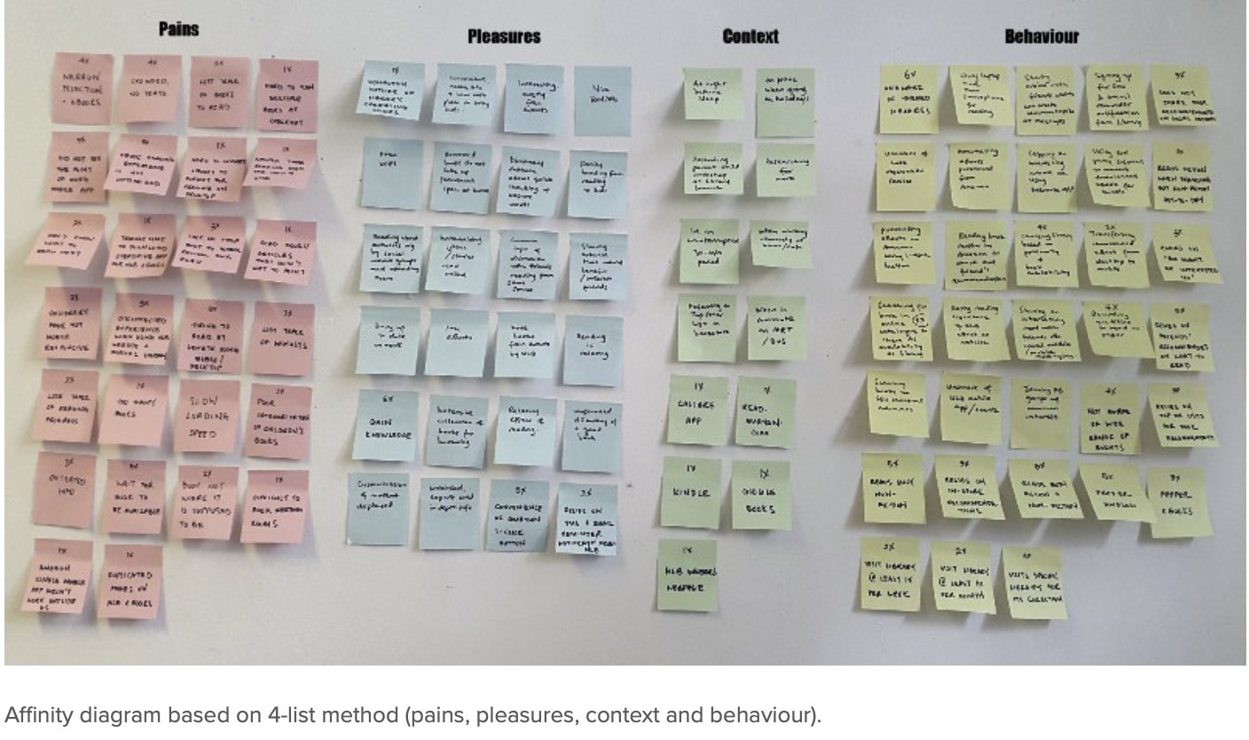
Activity 4: Example
Affinity diagram

Slide 23
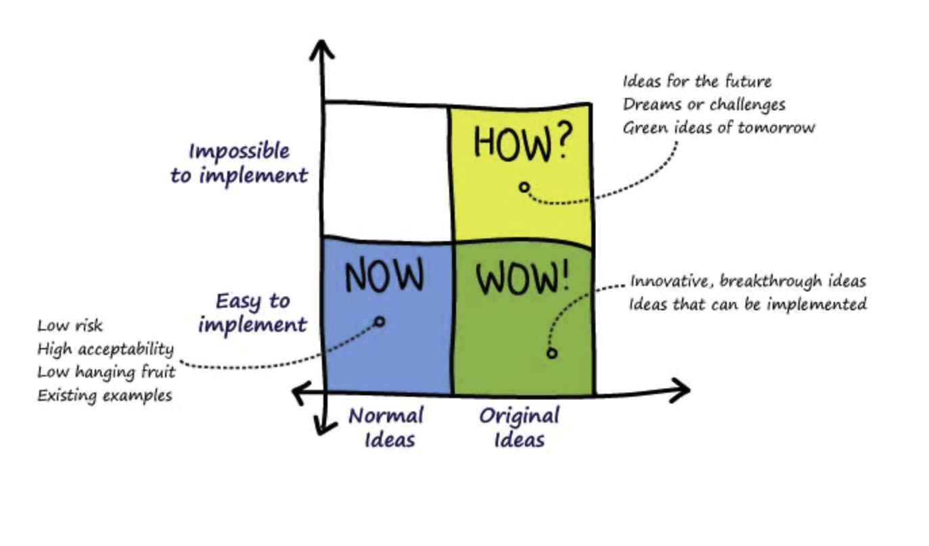
Activity 5: Choosing the best idea
The final step of ideation is to finalize the gathered and refined ideas and rank them according to the client X criteria.
Once students finish brainstorming and categorizing, they can start narrowing down to the best idea, solution, or strategy. The so-called post voting method allows them voting and expressing their opinion towards the best given ideas.
How Now Wow

Slide 24
Prototype and test

Slide 25
Activity 1: Cultural knowledge about target markets and communities
The following are the warm up exercises which could be done after all the stages of design thinking. Students finally have the necessary skills to prototype the actual product and test it in the market. These warm up activities give students the opportunity to understand the market and recognize the needs of a regular consumer, later offering them a (potentially) tangible and plausible solution.

Slide 26
Activity 2: Pitching
Monroe’s speech
Monroe’s speech is a technique for organizing persuasive speech. The technique consists of 5 steps. Following the steps the students would gain the skills of public speaking and persuasion.

Slide 27
Activity 2: Pitching
The hamburger method is a method of constructive criticism. This is a way to give your feedback in a polite and constructive way, to help the others to improve their ideas without getting offended. The key principle of a hamburger method is to criticize including initial and final complementing.

Slide 28
Activity 3: Attending meetings with real life professionals
Option 1
A few professionals are invited to the lectures. A roundtable discussion could be organized. The professionals from different fields could be invited (academic staff, entrepreneurs, employees of some global companies, researchers, business market experts, etc.)
Option 2 Preparing and conducting interviews
Students are analyzing the market. They have to choose a public figure, a professional in their field. The students are asked to prepare a questionnaire for an interview with the famous personality. Later on, 1 of the public figures could be invited to join the lecture or the best interview could be sent by e-mail to the actual person.

Slide 29
Activity 4: Creating a prototype
Lego structure copy
The students are working in small groups of 3 or 4. The same amount of Lego’s bricks is given to each group. Each group has the same amount of bricks, identical in its form. The students are choosing the roles inside the groups: the leader, the architect, the journalist, etc. The journalist sees the building made out of the bricks. He/she describes it to the leader. The architect is asked to build the identical figure according to his/her leader’s explanations.

Slide 30
Activity 5: Pitching to business agels
A simulation of a start-up fair could be organized. A few well-known entrepreneurs, students from other groups, academic staff members could be invited for a discussion. The students are asked to present their business idea and to present it in a short period of time.

